Slide 1
Fair Representation
Drew Spencer, Staff Attorney, FairVote

Slide 2
FairVote’s Key Reforms
National Popular Vote
The president should be elected by the people of the United States, not the swing states.
The Right to Vote
119 countries with elected legislatures, and over 90% of them guarantee the right to vote—the United States is one of the 11 that does not.
Ranked Choice Voting
In a plurality election with six candidates, someone can be elected with less than 17% of the vote.
Fair Representation Voting

Slide 3
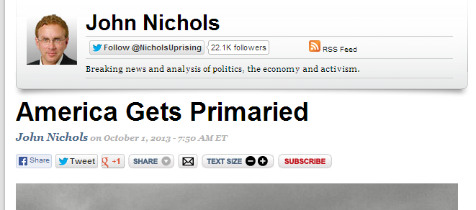
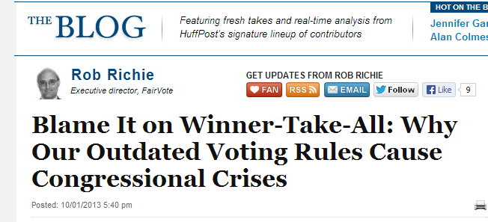
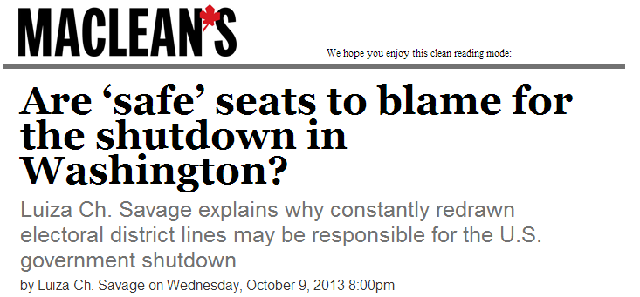
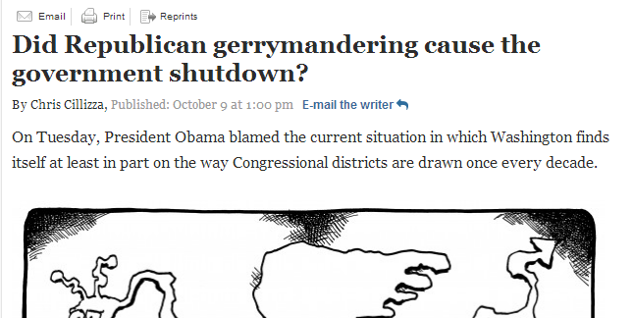
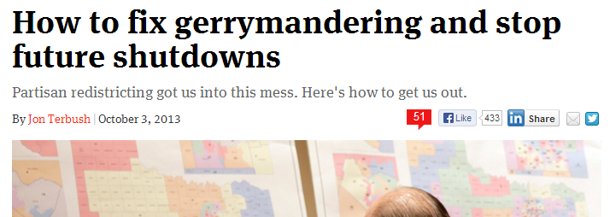
Polarization in the U.S. Congress

Slide 4
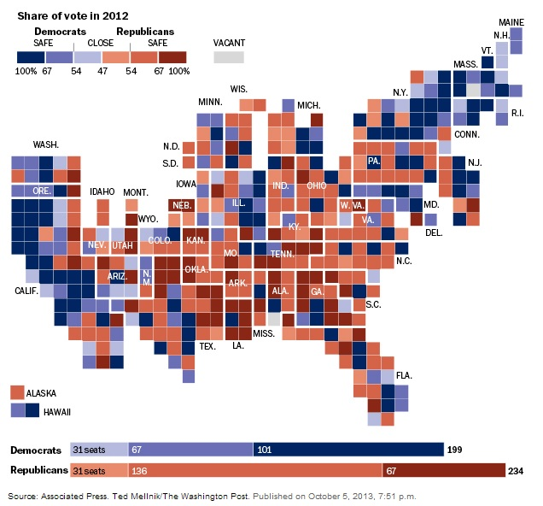
Winner-Take-All
51% = 1 seat
99% = 1 seat
49% = 0 seats
1% = 0 seats
58% or more for one party = SAFE district

Slide 5
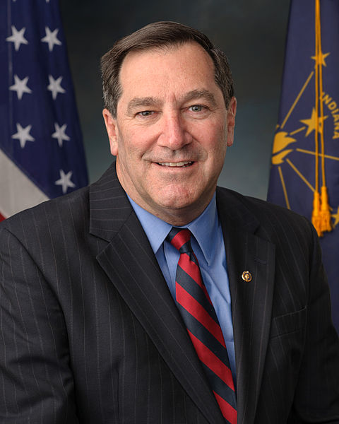
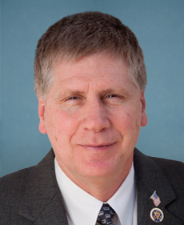
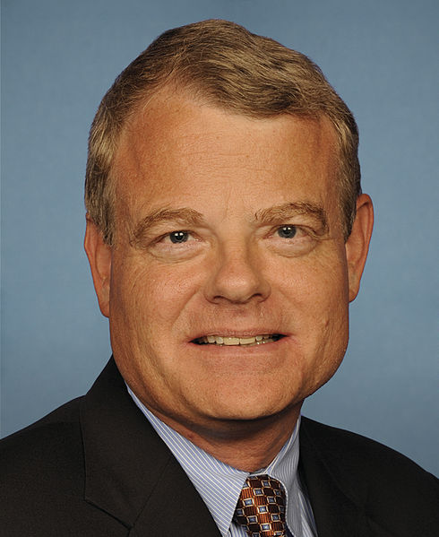
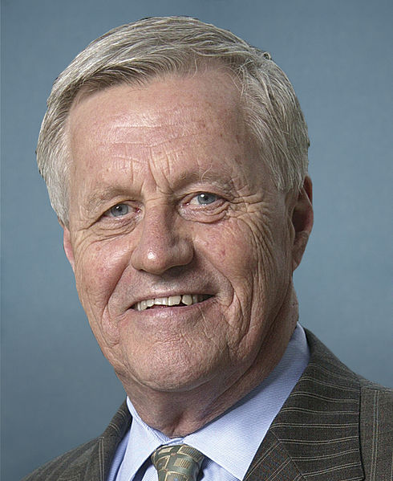
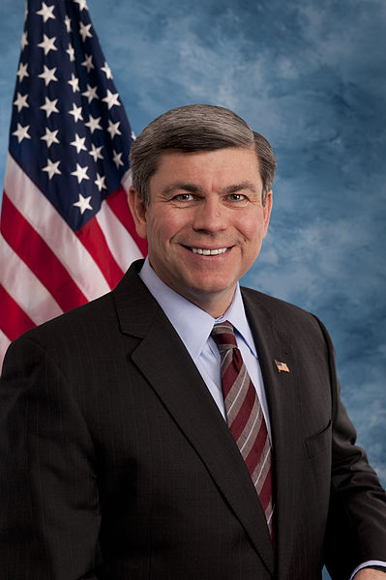
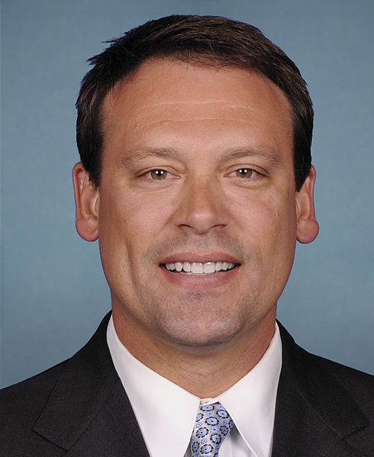
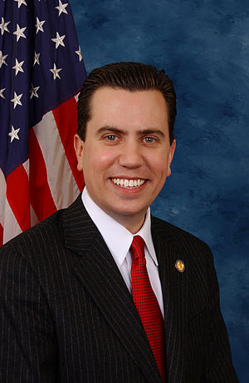
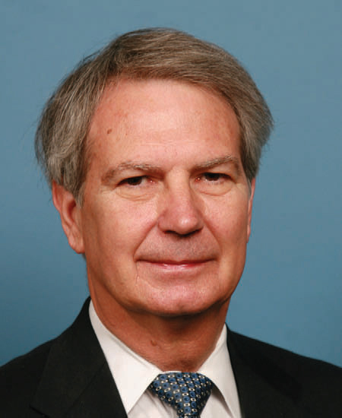
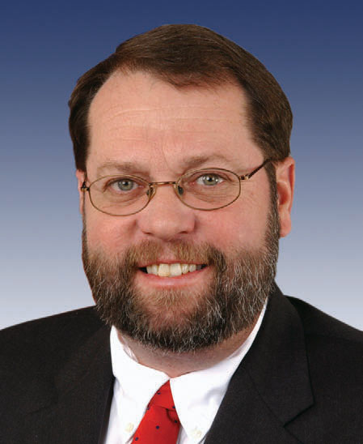
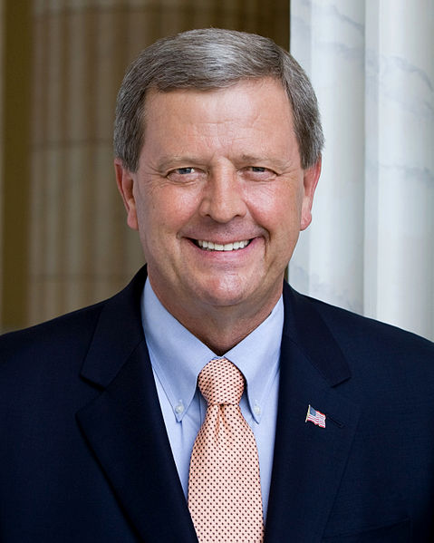
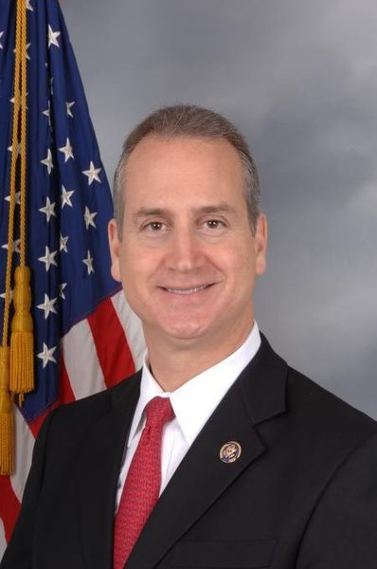
Safer Districts = Less Moderation
51%
49%
44%
45%
37%
37%
44%
30%
35%
46%
50%
45%
64% of Republicans from competitive districts voted in favor;
30% of Republicans from non-competitive districts voted in favor
Fiscal Cliff Vote (January, 2013):
56% of Democrats from competitive districts voted against;
12% of Democrats from non-competitive districts voted against
Democratic Budget (March, 2013):

Slide 6
Trend Toward Polarization
51%
49%
44%
45%
37%
37%
44%
30%
35%
46%
50%
45%
Number of “crossover” representatives in 1993: 113
Number of “crossover” representatives in 2013: 26
Percentage of moderates in the House in 1993: 24%
Percentage of moderates in the House in 2011: 4%
Distance between Republican and Democrat mean NOMINATE score in 1993: 0.740
Distance between Republican and Democrat mean NOMINATE score in 2011: 1.069

Slide 7
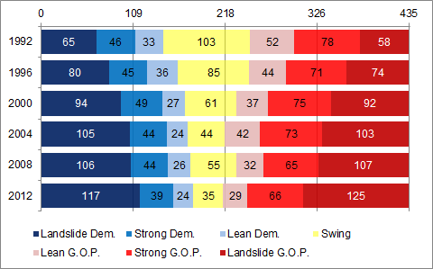
Decline in Competition

Slide 8
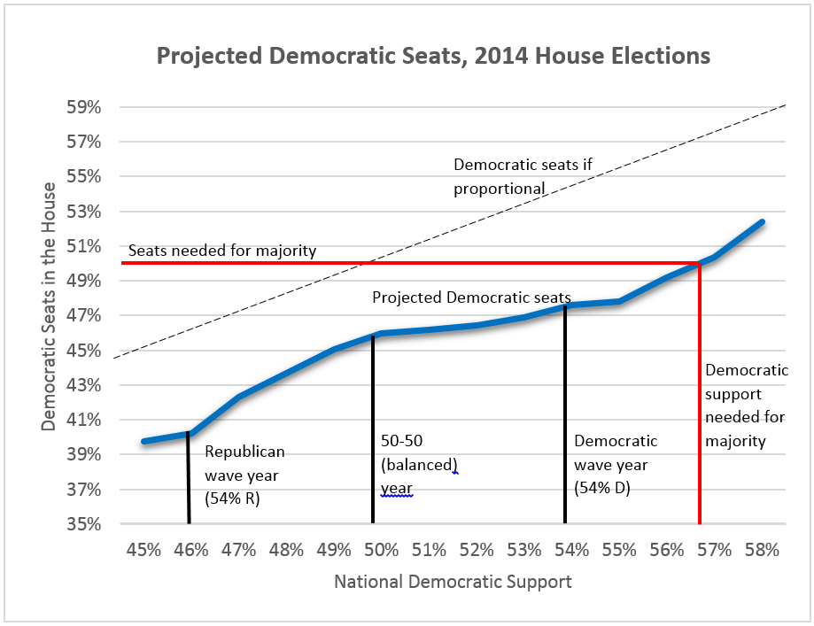
Partisan Skew

Slide 9
Cause of the Decline in Competition
Gerrymandering?
Closed primaries?
Money in politics?
The pattern exists between redistricting cycles and in states where independent commissions draw lines
Open primary states and “top two” states still have mostly uncompetitive districts. Political scientists largely believe that primary reform does not affect polarization.
States with public financing still have mostly uncompetitive districts, and candidates in skewed districts win even when outspent.
These issues may be important for other reasons,
but they do not address the underlying cause of polarization

Slide 10
Winner-Take-All

Slide 11
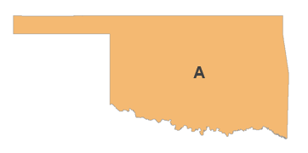
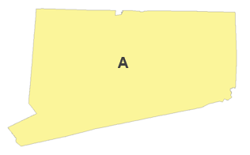
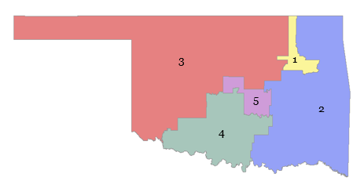
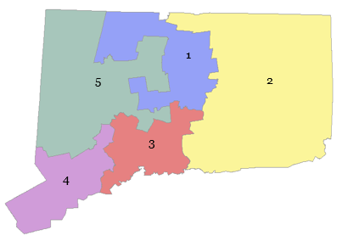
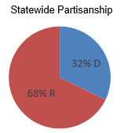
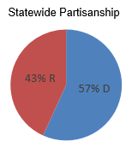
An Alternative to Winner-Take-All
Current plan: five Republicans
Current plan: five Democrats
FairVote plan: three Republicans, one
Democrat, and one “swing” seat.
FairVote plan: three Democrats, two
Republicans

Slide 12
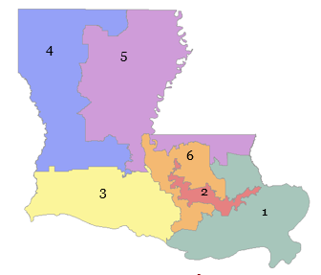
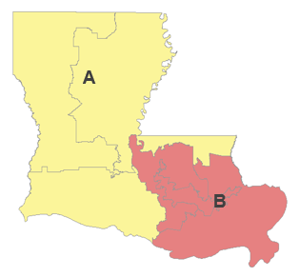
“Super Districts”

Slide 13
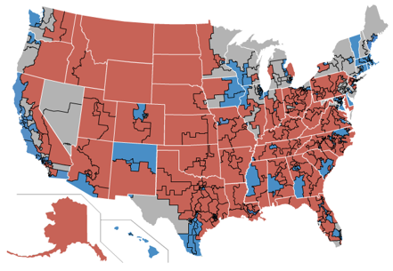
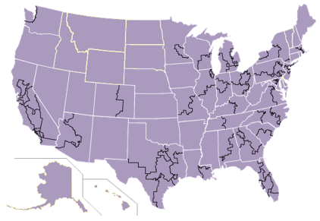
“Super Districts”
Visit http://fairvoting.us to see analysis and a map for every state

Slide 14
Fair Representation Voting in Illinois: 1870-1980
History
1865: End of U.S. Civil War. Illinois polarized between northern Republicans and Southern Democrats;
1870: Illinois Constitutional Convention due to government corruption;
1978: Illinois House adopts a pay raise, Governor Thompson campaigns against it in bid for re-election;
1980: The “Cutback Amendment” promises smaller legislature; ends the use of fair representation voting.
Illinois Assembly on Political Representation
Offers greater choice for voters in primary and general elections;
Provides prospective candidates easier access to the electoral system;
Provides greater representation for the minority political party in districts dominated by the other party;
Provide individual legislators greater independence from legislative leaders;
Generate richer deliberations and statewide consensus among all legislators since both parties would be represented in all parts of the state.

Slide 15
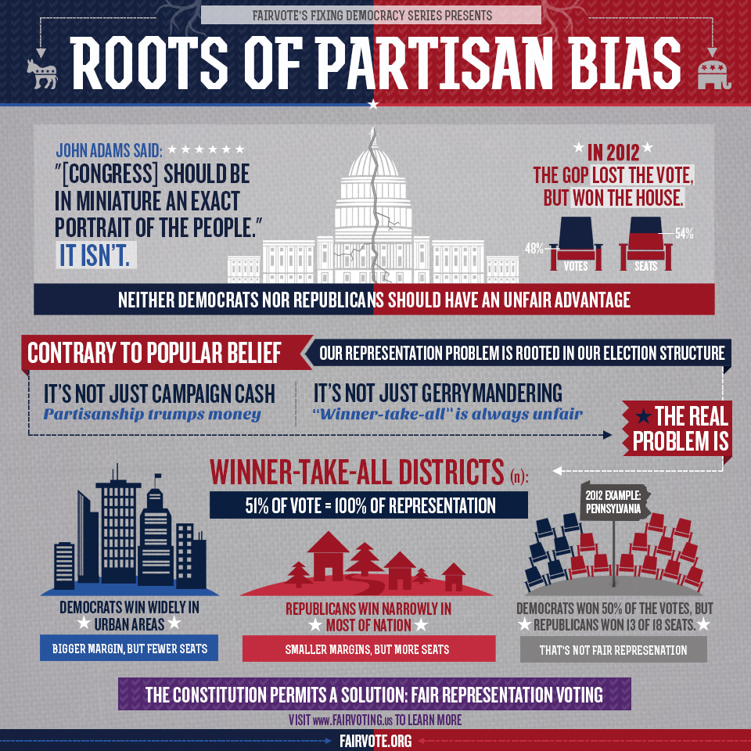
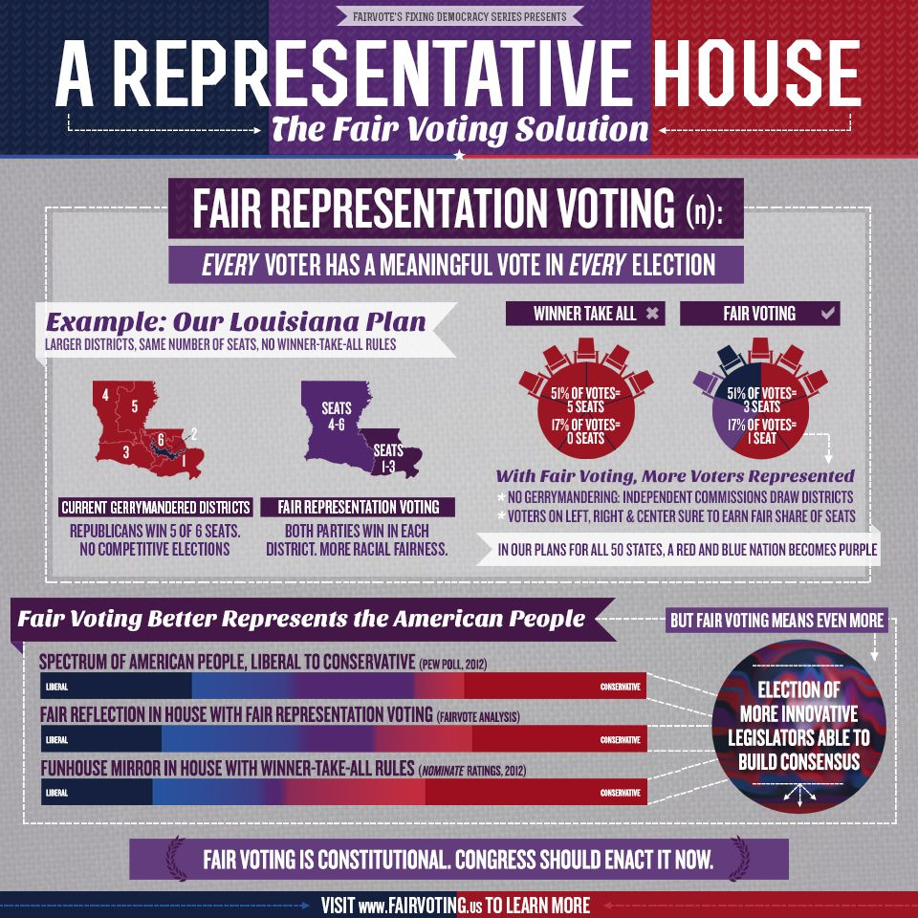
Fair Representation Voting
Proportional voting in super districts.
Constitutional: the Constitution never requires winner-take-all.
Grounded in American traditions

Slide 16
Fair Representation Voting

